Slide 1
03 BASIC OPERATIONS
Ashok Ranade

Slide 2
Basic operations on two signals
z(t) = x(t) + y(t)
z(t) = x(t)-y(t)
z(t) = x(t).y(t)
z(t) = x(t)/y(t)

Slide 3
Addition of two sines
Write a program to observe the resultant of addition of fundamental and second harominc
Use a common variable t to generate both the waveforms so that the number of samples generated are same
Plot x,y and z where
x is the fundamental sine wave
y is the second harmonic
z is the resultant

Slide 4
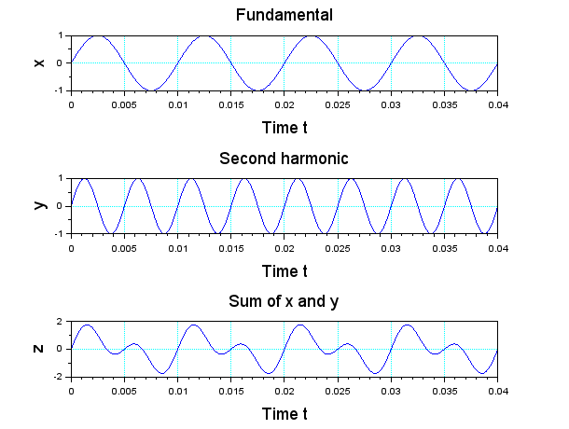
Expected output

Slide 5
Program
// Addition of two sine waves
clear; clf; clc;
f = 100; T = 1/f; ts = T/100;
t = 0:ts:4*T;
x = sin(2*%pi*f*t);
y = sin(2*%pi*2*f*t);
z = x + y; subplot(311);
plot(t,x);
plot(t,y);
plot(t,z);

Slide 6
Class assignment
Write a program to generate two sine waves say x and y
The frequency of x should be ten times the frequency of y
Then obtain z = x.y
In Scilab you need pointwise multiplication
z = x.*y
Plot x,y and z

Slide 7
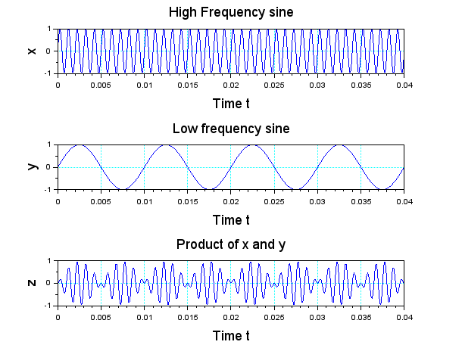
Expected output

